Slide 1

IS 312 Web Design and Programing
Module 01 – Introduction Coding Env, HTML and CSS
School of Technology & Computing (STC)
City University of Seattle (CityU)

Slide 2
Welcome To Web Design
Introduce the Web design and Development Ecosystem
Mapping Moden Web Landscape
Transform form Consumer to Creator
Notes:
Welcome, everyone. Today we are transitioning from people who simply consume the web to the engineers who build it. This lecture covers the foundational tools, execution workflows, and architectural concepts required to build production-ready applications.

Slide 3
The Modern Web Team
Product Managers & Designers
Frontend Developers vs. Backend Developers
DevOps & Security Operations(SecOps)
Notes:
Building a website at scale is a collaborative ecosystem. UI/UX designers create the visuals, frontend engineers translate those designs into code, backend engineers manage servers and databases, and DevOps/SecOps ensure continuous, secure deployment.

Slide 4
Essential Software Tools
Advanced Text Editors(VS Code, NeoVim)
Web Browsers & Developer Tools (DevTools)
Assets Optimizers & Graphic Software
AI based code generation and trouble shooting
Notes:
Your primary environment consists of a robust text editor and a browser. Browser DevTools act as an absolute necessity for inspecting the live DOM, debugging scripts, and analyzing real-time network traffic.

Slide 5
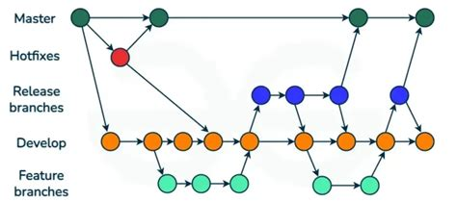
Version Control & Git Foundation
What is Version Control
Tracking Code Line by Line
Preventing File Duplication Chaos
Notes:
Before writing code, we must track it. Git is a distributed version control system. It takes snapshots of our codebase, allowing us to experiment safely without breaking working production environments.

Slide 6
Remote Collaboration and & Branching
Isolating Features via Branches
Centralized Remotes (GitHub, GitLab, Garrit)
`git push & git pull`
Notes:
Never build directly on your production master or main branch. We create feature branches to isolate changes. Once verified locally, we push our branch to a remote server like GitHub to share it with our engineering team

Slide 7
Peer Review & Continuous Integration
Pull Requests / Patch Sets
Code Review and Verification Testing
Merging Code Safely into Production
Notes:
Before code goes live, it goes through peer review via a Pull Request. Team members analyze line-by-line changes for bugs or compliance drift, automated tests verify the build, and only then is it merged into the main codebase.

Slide 8
Code Deployment Mechanics
Moving Code to Web Hosting Infrastructure
Production-Ready Environment
Secure Storage Containers
Notes:
Once code is merged, deployment mechanisms compile the assets and move them onto public cloud infrastructure or web hosting environments, making our code accessible to global users.

Slide 9
Introduction to Web Architecture
The Client-Server Blueprint
Decoupling Presentation from Storage
Requests and Response Lifecycles
Notes:
To build for the web, you must understand how data travels. Web architecture operates on a client-server model: clients request information, and servers store, process, and return that data.

Slide 10
The Client: Browser as Interpreters
What is a Client? (Chrome, Firefox, Safari)
Parsing Languages: HTML, CSS, JavaScript
Rendering Engine
Notes:
The client is the end-user's browser. Browsers are advanced translation engines. They take flat text files sent over the internet and interpret them into interactive, visual experiences.

Slide 11
The Server: Data Guardians
High-Availability Hardware Racks
Listening for Network Traffic
Serving Static Assets and Dynamic Data
Notes:
The client is the end-user's browser. Browsers are advanced translation engines. They take flat text files sent over the internet and interpret them into interactive, visual experiences.

Slide 12
Demystifying the URL
Uniform Resource Locator Structure
Protocol (http://, https://)
Domain Name (example.com)
Notes:
A URL is the explicit address of a resource on the internet. It tells the browser which communication protocol to use and defines the exact server destination host name to look for.

Slide 13
DNS: The Internet’s Phonebook
Domain Name System Translation
Mapping Names to IP Addresses
Global Server Lookups
Notes:
Computers don't communicate using names like 'google.com'; they use numerical IP addresses. The Domain Name System, or DNS, acts as a global lookup phonebook that instantly translates human-readable domain names into machine-routable IP addresses.

Slide 14
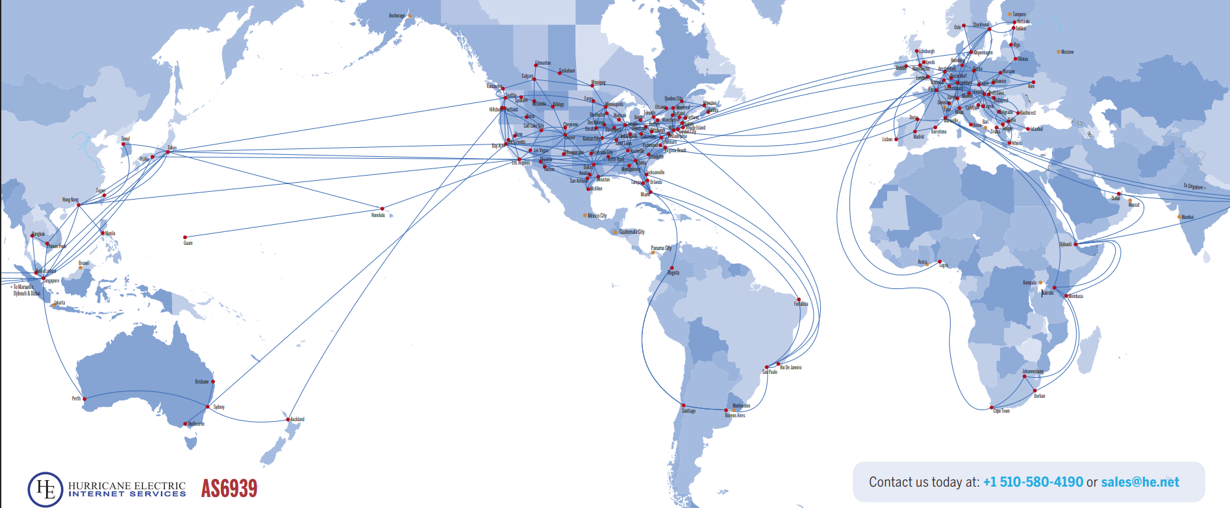
Hurricane Electric Network Map

Slide 15
Anatomy of an HTTP Request
HTTP Methods (GET, POST, PUT, DELETE)
Request Headers & Metadata
Transmitting the Payload
Notes:
When a browser asks a server for a page, it issues an HTTP request. A GET request asks for data, while a POST request sends data. The request headers contain metadata, like browser type and language preferences.

Slide 16
Anatomy of an HTTP Response
Server HTTP Status Codes
Success (200 OK ) vs Client Error (404 Not Found)
Server Failure (500 Internal Server Error)
Notes:
The server answers with an HTTP response containing a status code. 200 means everything loaded perfectly. 404 indicates the requested file does not exist, and 500 means the server's internal programming crashed.

Slide 17
Bandwidth and Network Latency
How File Size Impacts Performance
Network Packets and Travel Time
The Importance of Technical Asset Optimization
Notes:
Files traveling across the web are broken down into tiny packets. Large images or bloated scripts take longer to transmit over limited bandwidth, increasing latency. Optimizing asset sizes is critical for a fast user experience.

Slide 18
Cloud Infrastructure and Edge Hosting
Distributed Computing Networks
Content Delivery Networks (CDNs)
Moving Storage Closer to the User
Notes:
Modern websites don't sit on a single server in an office. They leverage global cloud infrastructures and Content Delivery Networks, or CDNs, which duplicate static assets across servers around the world to deliver data to users with minimal delay.

Slide 19
Core Web Design Philosophies
The Separation of Concerns
Progressive Enhancement
Cross-Browser Compatibility Expectations
Notes:
As we shift to development theory, we focus on foundational design philosophies. Our absolute core rule is the Separation of Concerns: splitting structure, style, and behavior into distinct layers.

Slide 20
Progressive Enhancement
Content First, Accents Second
Graceful Degradation Strategies
Accessibility for All Devices Tiers
Notes:
Progressive enhancement means building a bulletproof foundational core using plain HTML so that content is readable on any browser or screen reader. Once that foundation is solid, we layer on advanced CSS styles and JavaScript features for modern devices

Slide 21
Introduction to Web Accessibility
Design for All Users Regardless of Ability
Screen Readers and Assistive Technologies
Semantic Code Value
Notes:
Web accessibility means ensuring your application can be used by everyone, including individuals with visual, auditory, or motor impairments. Writing proper semantic code ensures that assistive tools like screen readers can easily parse your page layout.

Slide 22
Responsive Web Design Principles
One Codebase, Infinite Screen Sizes
Fluid Layout Grids vs Static Widths
Media Queries Adaption
Notes:
Websites are viewed on devices ranging from small smartwatches to massive 4K monitors. Responsive web design is the philosophy of using fluid grids and layout rules so a single codebase dynamically morphs to fit any screen resolution perfectly.

Slide 23
Document Object Model (DOM)
Living Memory Structure of a Page
How the Browser Maps HTML Elements
A Tree Hierarchy of Object Nodes

Slide 24
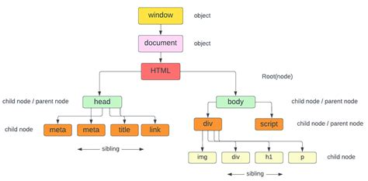

Slide 25
Anatomy of a HTML Document
Document type Declaration
  (<!DOCTYPE html/>)
Page Root Element
  (<html>)
Head vs Body Code Divisions
Notes:
Let's build a page. Every HTML5 document begins with a DOCTYPE declaration telling the browser to expect standard HTML5. This is followed by our root html tag, which splits into two main sections: the head and the body

Slide 26
The Head vs Body Element
<head> Hidden Document Metadata & Tab Titles
<body> Visible Content Layer
Structural Isolation Rules
Notes:
The <head> element contains information about the page—such as character encoding, page titles, and external stylesheets. The <body> contains the actual visible elements—headings, paragraphs, and images—that users interact with on screen.

Slide 27
Semantic Text Hierarchies
Heading Element( <h1> through <h6>)
Paragraph Tag Structures <p>
Establish a Clear Structural Outline
Notes:
We organize text using semantic tags. <h1> represents the main, most important title of the page, scaling down to <h6> for deep subheadings. Standard paragraph text blocks are wrapped inside <p> tags to maintain clean spacing.

Slide 28
Document Structural Formatting Elements
Header, Navigation, and Main content areas
<header>, <nav>, <main>
<footer> Document baseplate
Notes:
Avoid using generic containers for everything. Modern HTML5 provides explicit structural tags like <header> for branding, <nav> for menus, <main> for primary text, and <footer> for bottom boilerplate info, which clearly organizes your code layout.

Slide 29
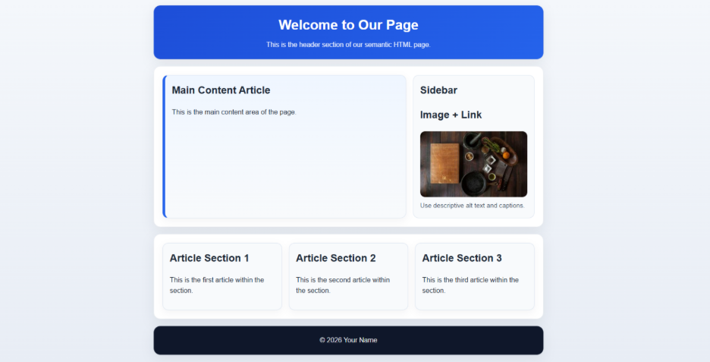
Structural formatting in Practice

Slide 30


Q&A

